Slide 1





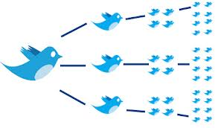






Social Media Analytics MSBA, Session 1, Jan 24, 2022
Dr. Anitesh Barua
David Bruton Jr. Centennial Chair Professor of Business
Distinguished Fellow, INFORMS Information Systems Society
University of Texas Distinguished Teaching Professor
Associate Director, Center for Research in e-Commerce
McCombs School of Business, University of Texas at Austin
Email: aniteshb@gmail.com

Slide 2
Course Details
1 group assignment
Finding influencers, community detection
Final project
Final exam (online, date TBA)
Readings
Parts of Easley & Kleinberg book (available for free from Cornell website)
Research articles (links provided in syllabus, some will be posted on Canvas)

Slide 3
Course Focus
Not a course on social media advertising
From content to connections
Extracting insights from a networked world
Why connections matter
Insights we can derive from connections
Predictions from connections
Concepts are common to any kind of network
Social
Professional
Internal corporate
E-commerce, etc.
But not just humans: Relationships between products, diseases, stocks, etc.
© Anitesh Barua, 2022

Slide 4
A Networked View of Stocks
 | s₁ | s₂ | …. | s_{n}
s₁ | 1 | c₁₂ | … | c_{1n}
s₂ |  | 1 | … | c_{2n}
… |  |  | 1…1 | …
s_{n} |  |  |  | 1
Stocks s_{i} and s_{j} (i ≠ j) will have a link (edge) if price correlation c_{ij} ≥ threshold.
Many important properties can be studied using network analytics
E.g., which stock is most important in explaining price movements of the group?
Other ways to create a network of stocks?
© Anitesh Barua, 2022

Slide 5
Topics to be Covered
Unique aspects of social media
Who’s important: Attention & influence
Visualization with networks
Detecting communities
Multi-mode networks
Link prediction
Homophily vs. social influence

Slide 6
Learning Objectives
Role(s) of social media in consumers’ purchase decisions (esp. high involvement goods)
Implications/insights about interplay between channels (e.g., social and paid search)

Slide 7
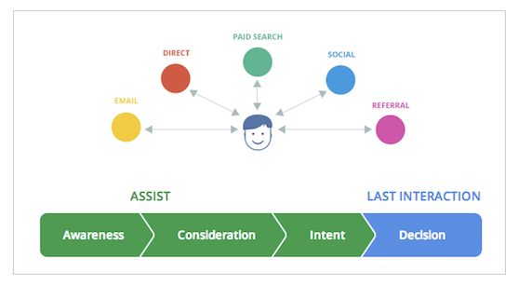
The Customer’s Journey to Online Purchase
Steps in a customer’s buying decision
Multiple “channels”, multiple interactions before purchase
A channel may be more important in “Assist” or “Last interaction” (conversion)
Data collected from 36k businesses using Google Analytics
Source: http://analytics.blogspot.com/2013/04/introducing-customer-journey-to-online.html

Slide 8
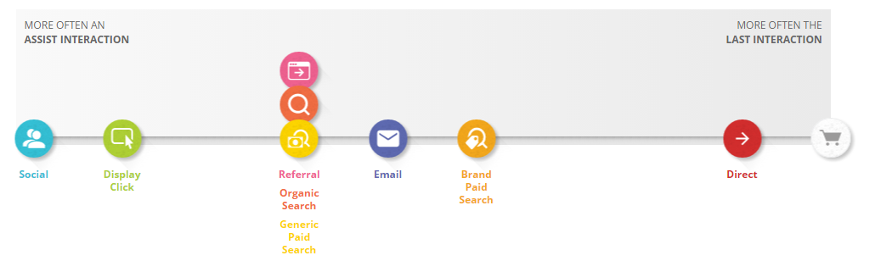
What Role Does Social Play?
Assist interaction: Any interaction that is on the conversion path but is not the last interaction.
Last interaction: The interaction that immediately precedes the conversion (i.e., clicking on the buy button).
Assist/Last interaction ratio = # times a channel was used in assist interaction / # times the channel was used for last interaction
E.g., in automotive, users visited a retailer’s website 30k times from a social site (e.g., Edmunds.com forum).
21.5k times the user did not buy immediately, but came back later from another channel (say, paid search link) and bought.
8.5k times users came from a social channel and bought immediately.
Assist/Last interaction = 21.5/8.5 = 2.5
>1
<1
Source: https://www.thinkwithgoogle.com/tools/customer-journey-to-online-purchase.html

Slide 9
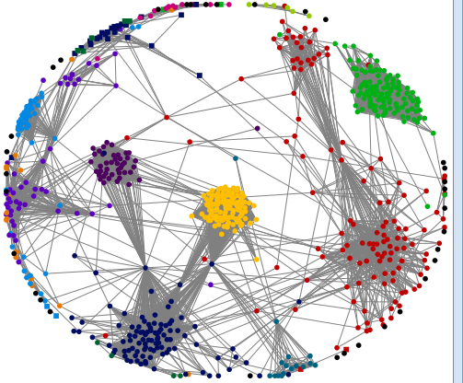
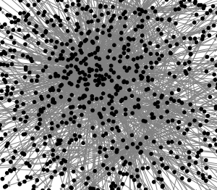
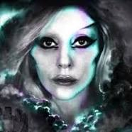
What’s Unique About Social Media? 1. “Democratization of the Lady Gaga Effect”
From channels to platforms
Conversations are now visible
Connections, attention,
influence, etc. can be measured
© Anitesh Barua, 2022

Slide 10
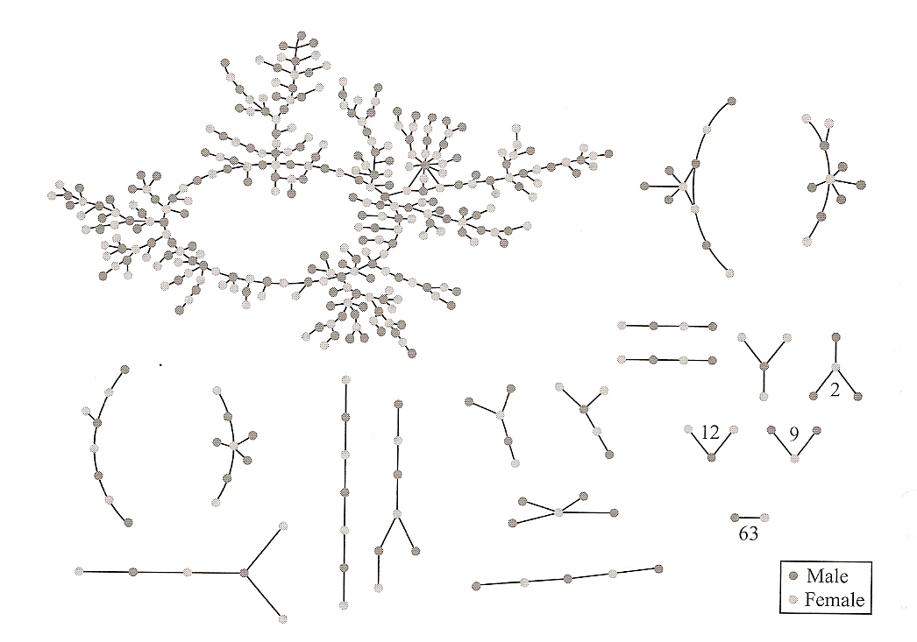
2. Network Structure
Can we learn from epidemiology?
Source: “Networks, Crowds and Markets”

Slide 11
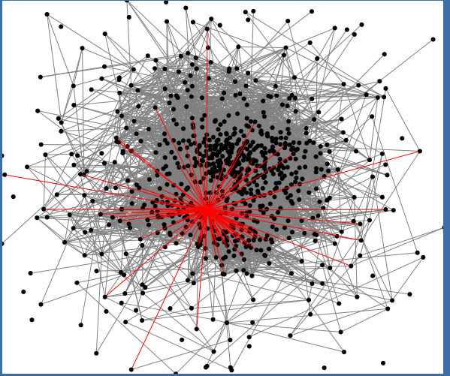
Your Network Location Matters
Who are most popular?
Who are “best” connected?
Who can help spread a message?
Who can help connect diverse groups?
Who’s that guy?
© Anitesh Barua, 2022

Slide 12
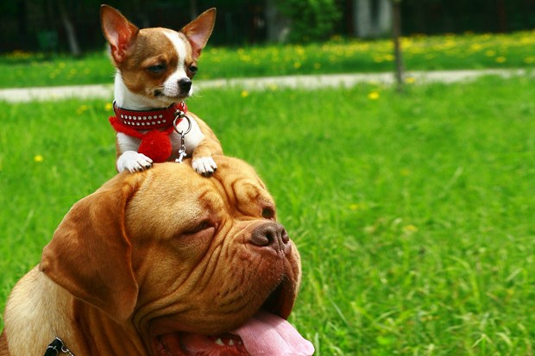
3. The Network Value of a Customer
From Customer Lifetime Value (CLV) to Customer Influence Value (CIV)
Customer Network Lifetime Value (CNLV) = CLV + CIV
© Anitesh Barua, 2022
Image Source: http://www.wired.co.uk/news/archive/2012-08/13/customer-network-lifetime-value

Slide 13
4. Monitoring & Visualization Through Social Media
Unprecedented real time visibility into
Public reactions
Emerging phenomena or events
Customer preferences
© Anitesh Barua, 2022

Slide 14
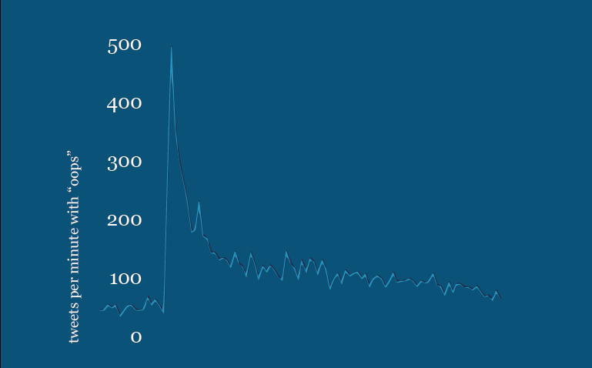
Real-time Assessment of Sentiment & Opinion: The “Oops” Tweets
X100
Source: April Underwood, Twitter

Slide 15
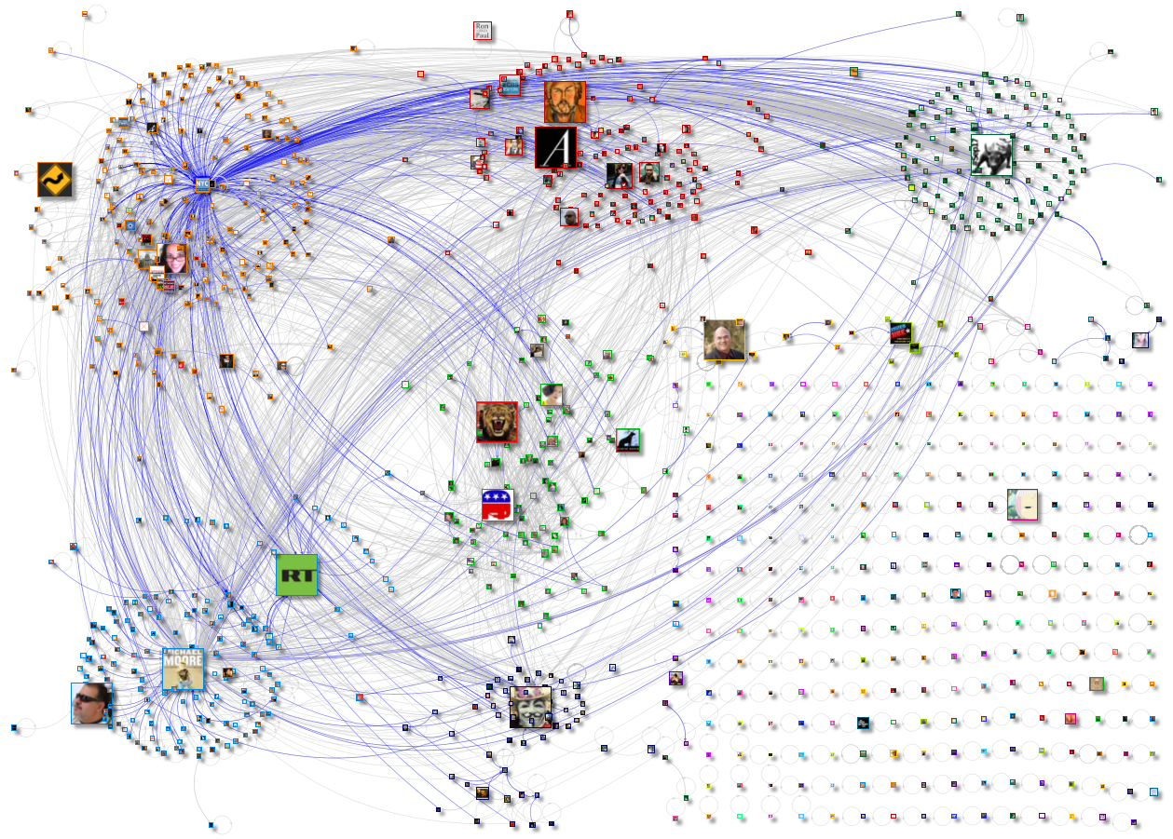
Tweets, Re-tweets: What do They Say?
Source: www.newscientist.com

Slide 16
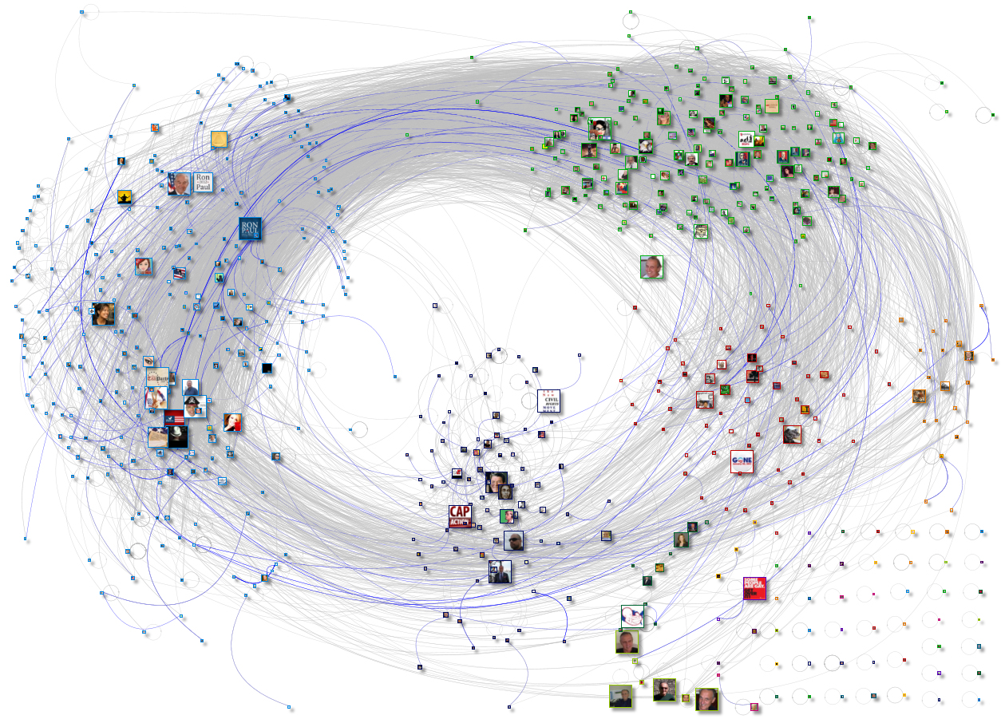
How is This Different From the Previous Network?
Source: www.newscientist.com

Slide 17
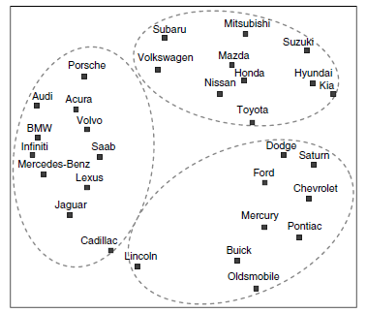
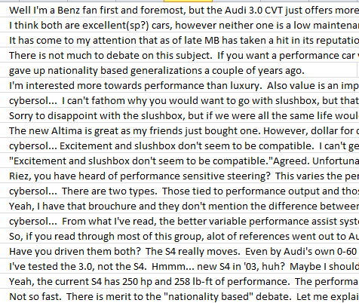
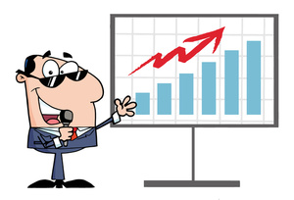




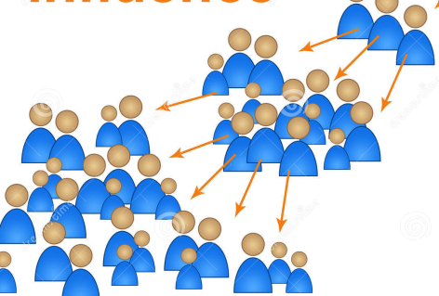
Business Implications of Social Media (Beyond Advertising and Promotions)
Obtain insights:
Analyze brand
& product
associations
Predict:
E.g., salesrank,
retention, spend,
etc.
Metrics, metrics & more metrics
Create new
products/services
Who matter most:
Find influencers,
groups with common interests
© Anitesh Barua, 2022

Slide 18
Takeaways
Social media conversations create new opportunities for business
Observe, engage & discover
Not just ‘a’ customer but customers embedded their social networks
Individual CLV to CIV and CNLV
The voice & connections of the customer
© Anitesh Barua, 2022

Slide 19
Next Class (1/26)
Network metrics & applications
Visualization of networks

